Slide 1
ReneWind
Predictive Maintenance: A Classification problem
Uday Poluri | 26-Jan-2026

Slide 2
Contents / Agenda
Executive Summary
Business Problem Overview and Solution Approach
Data Overview
Data Preprocessing
Model Evaluation Criterion
Methodology
Model Performance Summary
Test Performance of Best Model
Appendix

Slide 3
Executive Summary
The Goal: The project aims to predict generator failures, before they occur. By identifying these issues early, we can repair generators proactively, avoiding unplanned downtimes and maintenance costs.
Methodology and Development
Data Exploration & Cleaning: We analyzed historical data to uncover hidden patterns and correlations. We also cleaned data (handling missing values or unusual readings) to ensure the model is making decisions based on high-quality, reliable information.
Establishing a Baseline: We started with a standard model to set a performance benchmark. This gave us a clear starting point to measure all future improvements against.
Model Optimization: We used advanced tuning techniques to refine the model performance. This step ensured we identified the most accurate model.
Model Evaluation and Performance
Our primary objective is to minimize False Negatives - cases where the model fails to detect a breakdown, so that we can eliminate unplanned outages, prevent high maintenance costs, and ensure operational reliability.

Slide 4
Executive Summary
Model Evaluation & Performance
We have developed a neural network (Model 4) that identifies generator failures with 99% accuracy.
The model successfully balances the need to catch the potential failures before they occur to avoid expensive replacements and unplanned production outages
Key Outcomes
High Detection Rates (Recall): The model identifies 93% of failures across the dataset. This ensures majority of the generator issues are flagged for inspection before a breakdown occurs.
Low False Alarm Rate (Precision): When model predicts a failure, its correct 98% of the time. This ensure maintenance inspection is performed only when there is a genuine need.
Reliability (F1 Score): Model is achieved 95% of F1 score on unseen data, proving its robust and ready for production deployment.

Slide 5
Business Problem Overview and Solution Approach
Business Problem
Wind energy is an important renewable energy alternative, however the sector faces high operating expenditures and unplanned outages due to generator failures.
The cost of replacing a generator is significantly higher than the cost of proactive repair or a routine inspection, therefore predicting the machinery failures is critical to minimize the operating costs.
Objective
To develop a predictive classification model that identifies the early signs of failures. Success is defined by minimizing the false negatives and capturing potential failures accurately.
Solution Approach
Exploratory
Data Analysis
Data Modeling
& Fine tuning
Actionable
Insights
Monitoring &
Value assessment
Data gathering
Cleaning
Feature engineering
Understanding patterns and insights
Machine Learning modeling
Data validation
Optimize model for better performance
Process improvements
Monitor model performance
ROI measurement
Improve and iterate

Slide 6
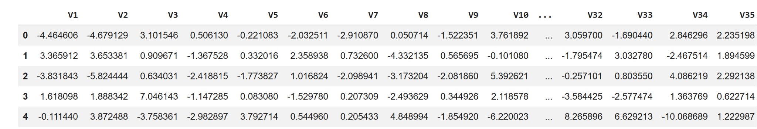
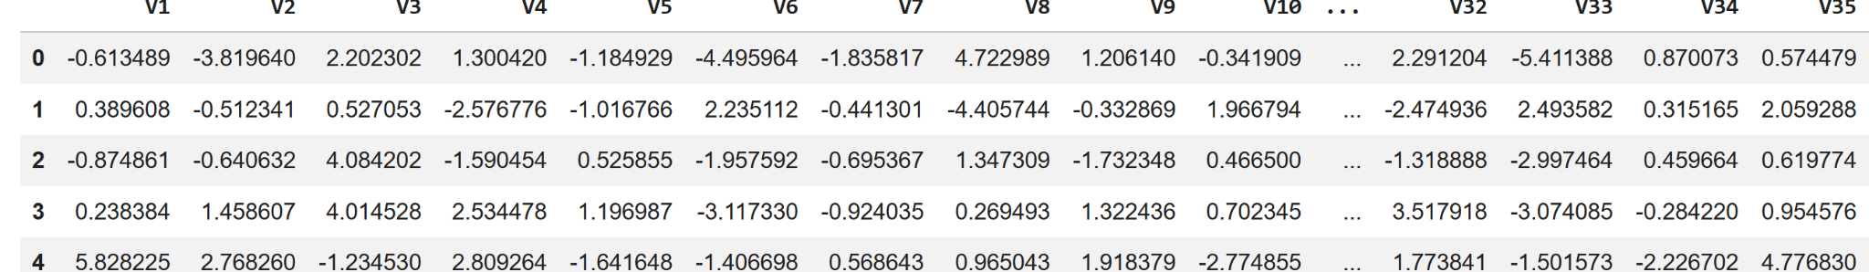
Data Overview
Data is Ciphered version of sensor readings.
Environmental data (temperature, humidity, wind speed, etc.)
Various parts of the wind turbine (gearbox, tower, blades, break, etc.).
Data Source
Train.csv; Test.csv
Size of the Data
Train: 20,000 Observation and 40 Predictors
Test: 5,000 Observations and 40 Predictors
Training Data
Test Data

Slide 7
Data Preprocessing
Duplicate value check - Training and Test data sets have no duplicate records.
Missing value treatment -
Training and Test data have few missing v1 and v2 attributes data.
Missing values were treated by imputing them with median values.
Feature engineering
The data is a Ciphered version to maintain the confidentiality of sensor data; Its already transformed and scaled.
No new features were created.

Slide 8
Data Preprocessing
Data preparation for modeling
Training data was split into Train (80%) and Validation (20%) sets using stratified split to maintain consistent class distribution across both subsets.
After split:
Training data: 16,000 Observations and 40 Predictors
Validation data: 4,000 Observations and 40 Predictors
Test data: 5,000 Observations and 40 Predictors
We performed Model training using Training set, Hyperparameter tuning using Validation set and finally benchmark tested against the Test set.

Slide 9
Model Evaluation Criterion
Strategy: The model performance is evaluated based on the following classification outcomes:
True Positives
False Positives
False Negatives
Successful prediction of a generator failure.
Proactive repairs and minimal downtime.
Incorrectly predicting a failure for a functional generator.
Unnecessary inspection and labor costs, though there is no downtime.
Failure to predict a generator failure
Costly replacement and an unplanned outage.
Evaluation Criteria: The selection of the primary metric is driven by the hierarchy of costs associated with each error type:
Replacement Costs > Repair Costs > Inspection Costs

Slide 10
Model Evaluation Criterion
Because the financial impact of a replacement (False Negative) is far higher than an inspection (False Positive), our primary objective is to maximize the detection rate of actual failures.
Based on these risks and costs, we used Recall as our primary metric for evaluating model performance. Recall = True Positives / (True Positives + False Negatives)
By optimizing the model for Recall, the occurrences of False Negatives can be minimized and potential failures accurately captured.

Slide 11
Methodology: Modeling, Optimization, and Evaluation
Evaluation
Criteria
Data Preparation
Baseline Modeling (Default Parameters)
Hyperparameter Tuning
Model Performance Evaluation
Final Model

Slide 12
Model Performance Summary
Model | Architectural Highlights | Accuracy | Recall | Precision | Key Takeaways
Baseline | Single Hidden Layer; RELU, Sigmoid, SGD, Binary Cross Entropy | T: 0.987 V: 0.987 | T: 0.903 V: 0.899 | T: 0.977 V: 0.972 | Established baseline; High False Negatives
Model 1 | 3 Hidden Layers; RELU, Sigmoid, SGD, Binary Cross Entropy | T: 0.987 V: 0.984 | T: 0.898 V: 0.879 | T: 0.978 V: 0.970 | Not much improvement with Depth.
Model 2 | 3 Hidden Layers; 40% Dropout RELU, Sigmoid, SGD, Binary Cross Entropy | T: 0.979 V: 0.978 | T: 0.830 V: 0.833 | T: 0.965 V: 0.953 | Performance drop; Information loss due to dropout.
Model 3 | 3 Hidden Layers; 45% Dropout; Class weights; RELU, Sigmoid, SGD, Binary Cross Entropy | T: 0.980 V: 0.978 | T: 0.929 V: 0.918 | T: 0.896 V: 0.886 | Improved Recall; effective at capturing minority class, but suffered on majority.
Model 4 | 2 Hidden Layers; Epochs:50, Batch: 64; RELU, Sigmoid, Adam, Binary Cross Entropy | T: 0.993 V: 0.991 | T: 0.947 V: 0.934 | T: 0.968 V: 0.958 | Best Accuracy, Recall and Precision; Optimal performance.
Model 5 | 3 Hidden Layers; Epochs: 50, 50% Dropout RELU, Sigmoid, Adam, Binary Cross Entropy | T: 0.981 V: 0.982 | T: 0.832 V: 0.842 | T: 0.987 V: 0.984 | Dropout continues to degrade the performance
Model 6 | 3 Hidden Layers; 50% Dropout; Class weights; RELU, Sigmoid, Adam, Binary Cross Entropy | T: 0.07 V: 0.069 | T: 0.481 V: 0.484 | T: 0.069 V: 0.068 | Overregularization led to poor performance.

Slide 13
Model Performance Summary
After iterating through six neural network configurations, Model 4 (Dual-layer, Adam optimizer) emerged as the most robust solution.
We observed that while Class Weighting (Model 3) helped prioritize failures, the combination of Adam's adaptive learning rate and increased depth in Model 4 yielded the best balance, achieving a 93.5% Recall.
Dropout consistently degraded performance across all tests, suggesting that the model requires all available feature signals to distinguish failure patterns in this specific dataset.
Link to Appendix slide on model assumptions

Slide 14
Best Model “Model 4” - Test Performance
Architecture
Epochs:50 Batch: 64; 2 Hidden Layers; Hidden Layer 1 : 14 neurons; RELU Hidden Layer 2: 7 neurons; RELU | Output Layer: 1 Neuron; Sigmoid Optimization: Adam Loss function: Binary Cross Entropy
Hidden Layer 1
v1
a11
Hidden Layer 2
v2
a12
a21
v3
a13
a22
Output Layer
Input Layer
v4
a112
a26
V 37
Output: 0/1
0: Negative
1: Positive
a113
a27
V 38
V 39
a114
V 40

Slide 15
Best Model “Model 4” - Test Performance
Test Results - Model generalizes well on unseen data with no signs of overfitting.
Accuracy (0.9906): The model currently identifies 99% both failures and non-failures.
Recall (0.9300): The model captures 93% of all generator failures.
Precision (0.9790): 98% of times model predicts the failures correctly, indicating very low false alarms.
F1 Score (0.9534): There is a robust balance between Recall and Precision.
Deployment Readiness
Model met all performance benchmarks and is recommended for production deployment.
Link to Appendix slide on model assumptions

Slide 16
APPENDIX

Slide 17
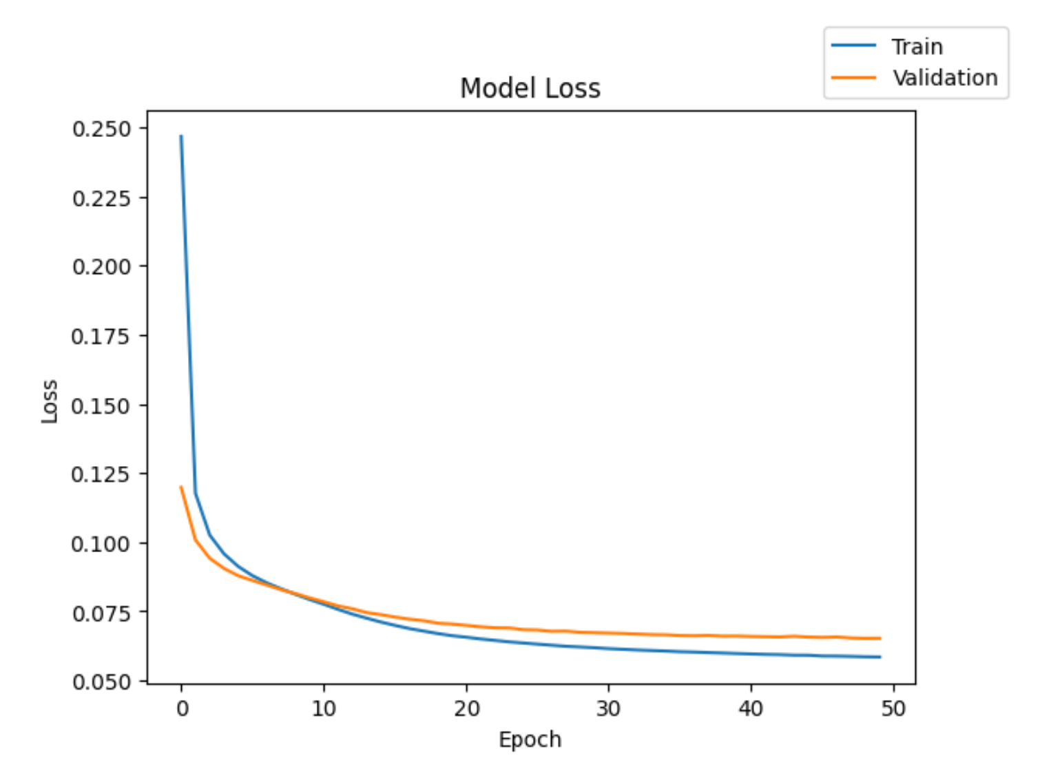
Model Performance : Initial Model
Predictors
40
Hidden Layers
# Neurons
Activation Function
Output Layer
Activation Function
Optimizer
SGD
Epochs
50
1
7
Relu
1
Sigmoid
Loss Function
binary_crossentropy
Batch Size
64
Metric
Recall
Execution Time
34.67 sec
Data | Accuracy | Recall | Precision | F1 Score
Training | 0.987 | 0.9034 | 0.9776 | 0.9370
Validation | 0.987 | 0.8998 | 0.9727 | 0.9328
The initial model achieved 98% overall accuracy. However the Recall is 90% which indicates that model is still missing 10% of actual generator failures.
The missed detection will result in significant replacement costs and unplanned downtime. So, our next steps will focus on fine tuning the model to improve Recall.

Slide 18
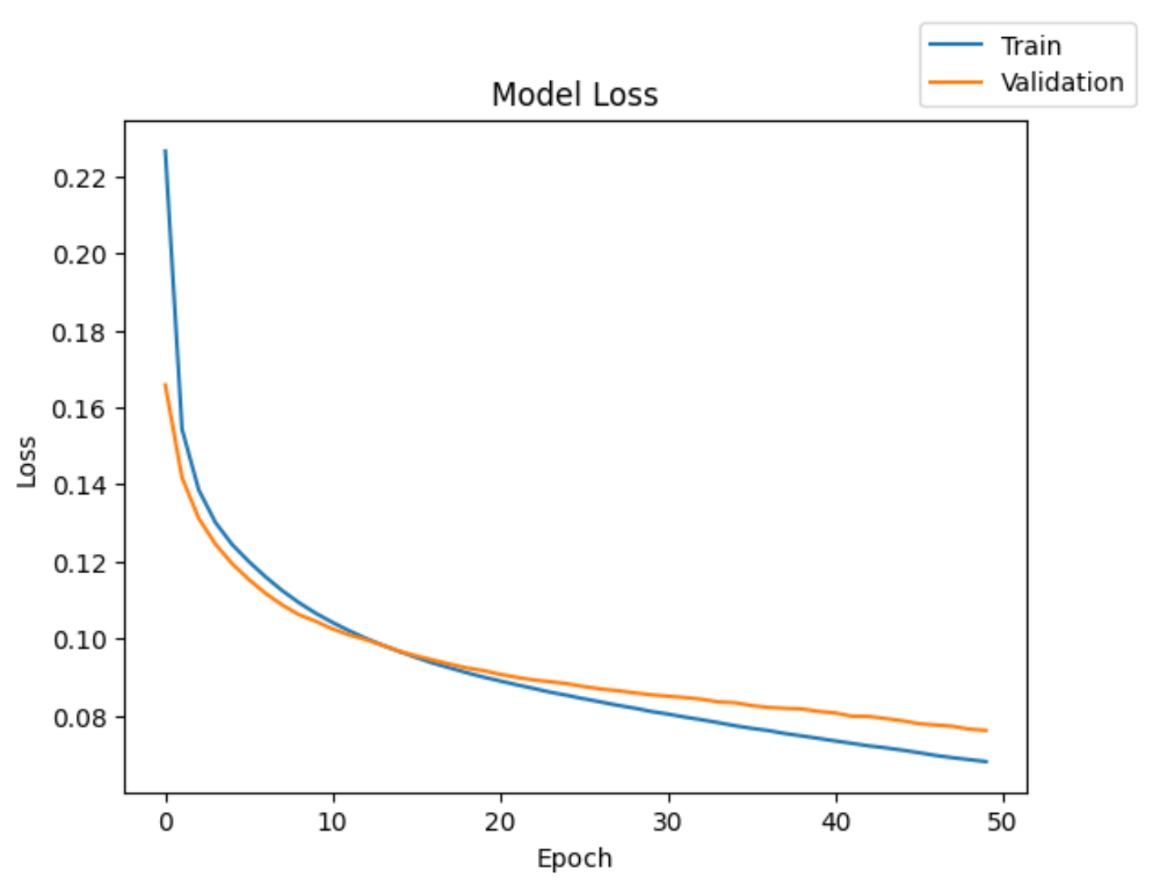
Model Performance : Model 1
Predictors
40
Hidden Layers
# Neurons
Activation Function
Output Layer
Activation Function
Optimizer
SGD
Epochs
50
1
14
Relu
1
Sigmoid
Loss Function
binary_crossentropy
Batch Size
64
2
7
Relu
Metric
Recall
Execution Time
37.06 sec
Data | Accuracy | Recall | Precision | F1 Score
Training | 0.987375 | 0.898451 | 0.978428 | 0.93433
Validation | 0.98475 | 0.879572 | 0.970469 | 0.919546
There is slight improvement in Recall, but not significant.
Classification Report shows that model is predicting the negative cases (no failures), but making significant errors in predicting positive cases (failures).

Slide 19
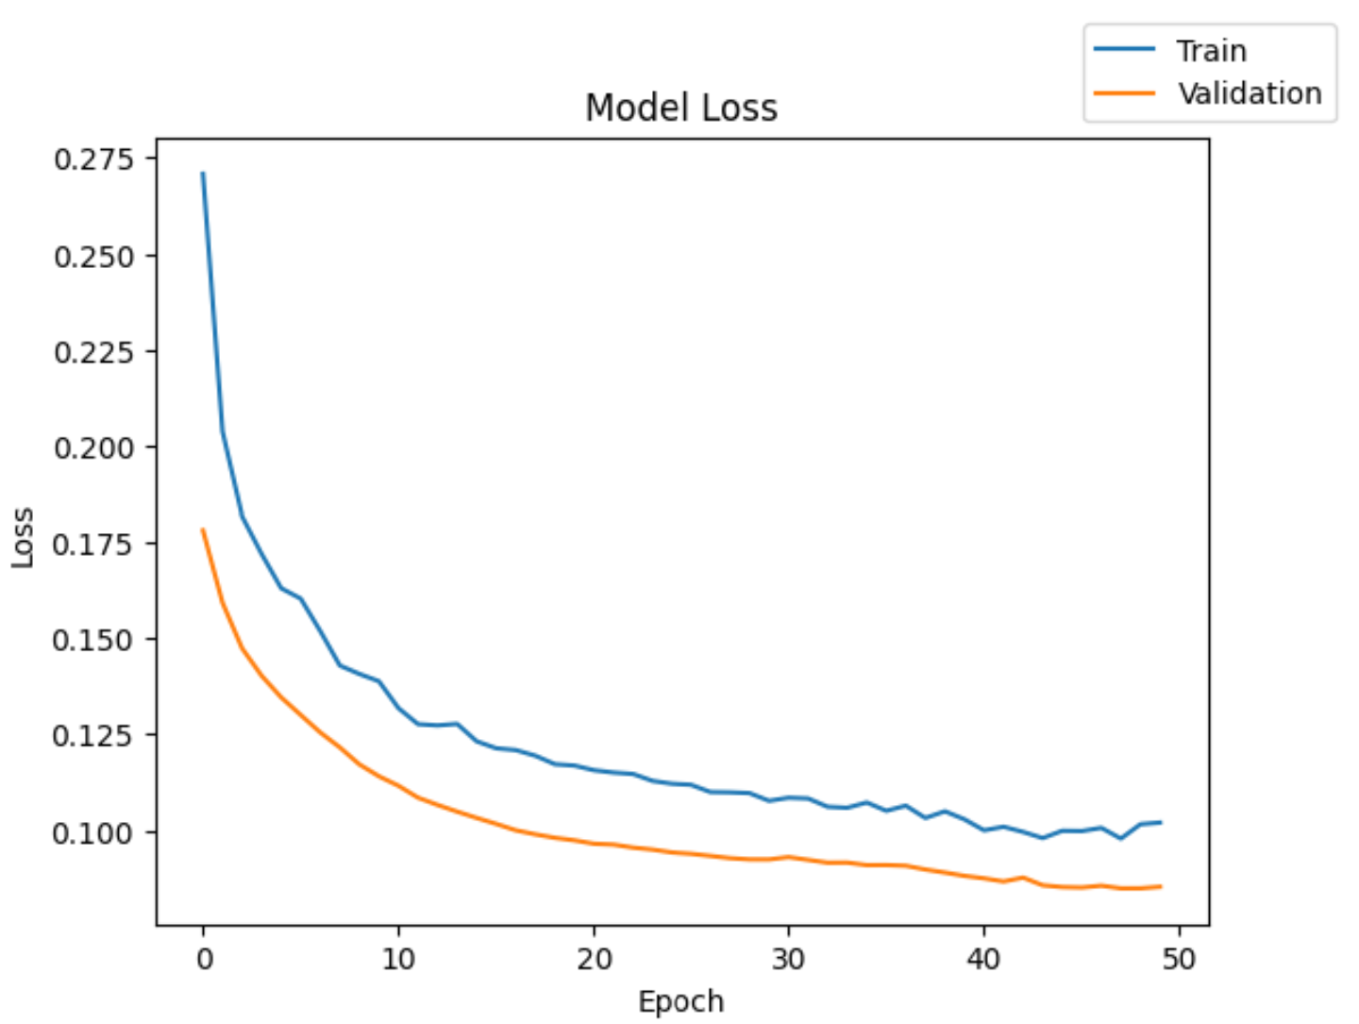
Model Performance : Model 2 - Dropout
Predictors
40
Hidden Layers
# Neurons
Activation Function
Dropout
Output Layer
Activation Function
Optimizer
SGD
Epochs
50
1
14
Relu
0.4
1
Sigmoid
Loss Function
binary_crossentropy
Batch Size
64
2
7
Relu
-
Metric
Recall
3
7
Relu
-
Execution Time
42.06 sec
Data | Accuracy | Recall | Precision | F1 Score
Training | 0.979313 | 0.830055 | 0.965207 | 0.884752
Validation | 0.97875 | 0.833997 | 0.953225 | 0.883454
Recall went down indicating model is still struggling to predict the failures accurately.
The model performance suffered with dropping the 40% of output from first hidden layer, indicating loss of information.

Slide 20
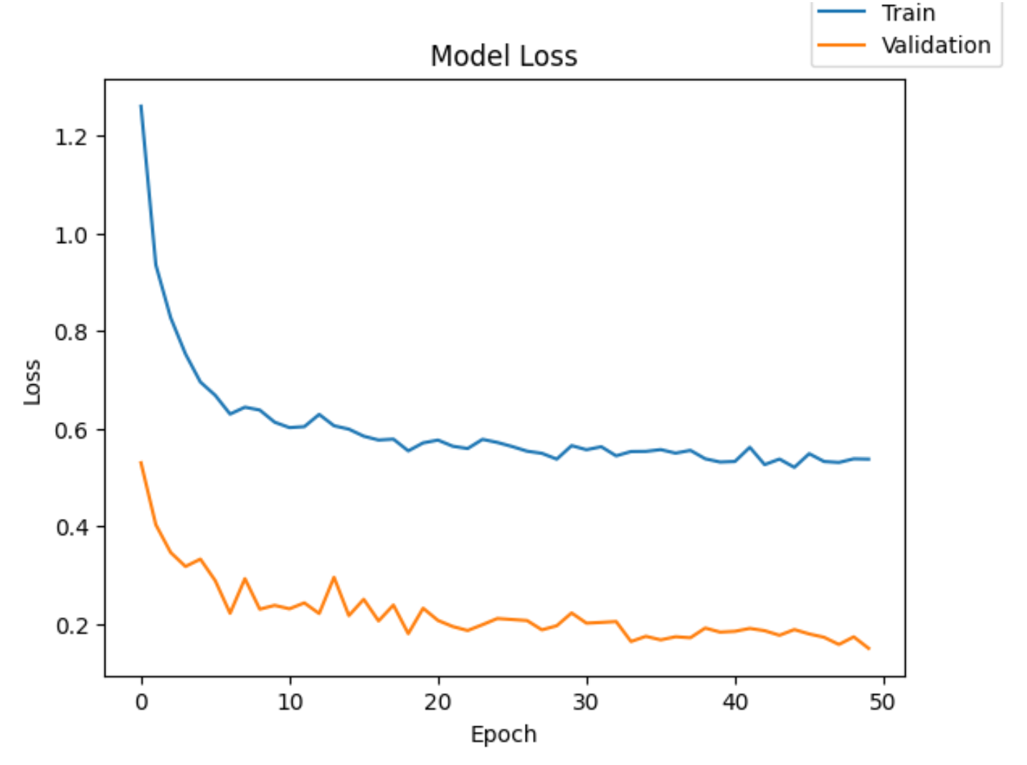
Model Performance : Model 3 - Class weight
Predictors
40
Hidden Layers
# Neurons
Activation Function
Dropout
Output Layer
Activation Function
Optimizer
SGD
Epochs
50
1
14
Relu
0.5
1
Sigmoid
Loss Function
binary_crossentropy
Batch Size
64
2
7
Relu
-
Metric
Recall
Class
Class Weight
3
7
Relu
-
0
1.0587
Execution Time
41.13 sec
1
18.01
Data | Accuracy | Recall | Precision | F1 Score
Training | 0.98075 | 0.929392 | 0.896001 | 0.911917
Validation | 0.9785 | 0.918661 | 0.886105 | 0.901622
A penalty of 18.01 is applied on incorrect prediction of positive cases to address the class imbalance in the data set.
The Recall is improved slightly, but the model is still making errors in predicting the failure cases.
Gradient descent is not smooth, there is a significant gap between training and validation data sets gradient descent.

Slide 21
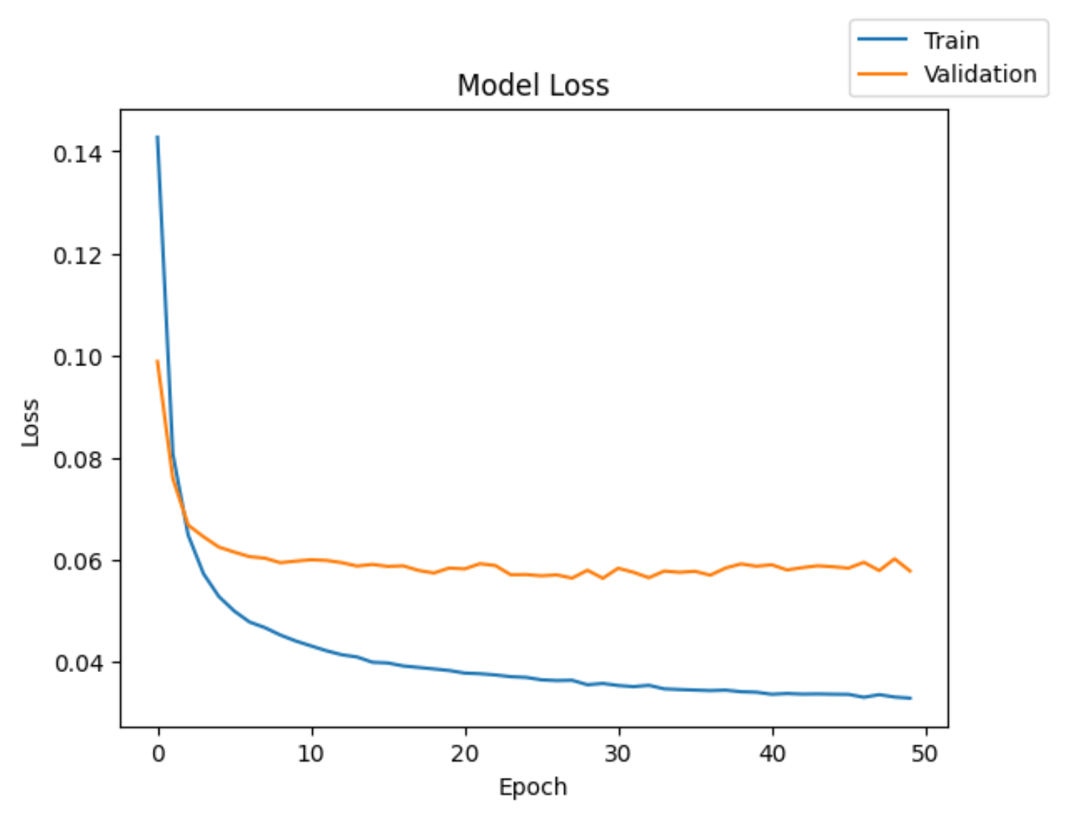
Model Performance : Model 4 - Adam Optimizer
Predictors
40
Hidden Layers
# Neurons
Activation Function
Dropout
Output Layer
Activation Function
Optimizer
Adam
Epochs
50
1
14
Relu
-
1
Sigmoid
Loss Function
binary_crossentropy
Batch Size
64
2
7
Relu
-
Metric
Recall
Execution Time
44.01 sec
Data | Accuracy | Recall | Precision | F1 Score
Training | 0.993625 | 0.947337 | 0.991343 | 0.968175
Validation | 0.99175 | 0.934155 | 0.986035 | 0.958444
There is an improvement in both Accuracy and Recall scores.
By far, this model has the best performance so far.

Slide 22
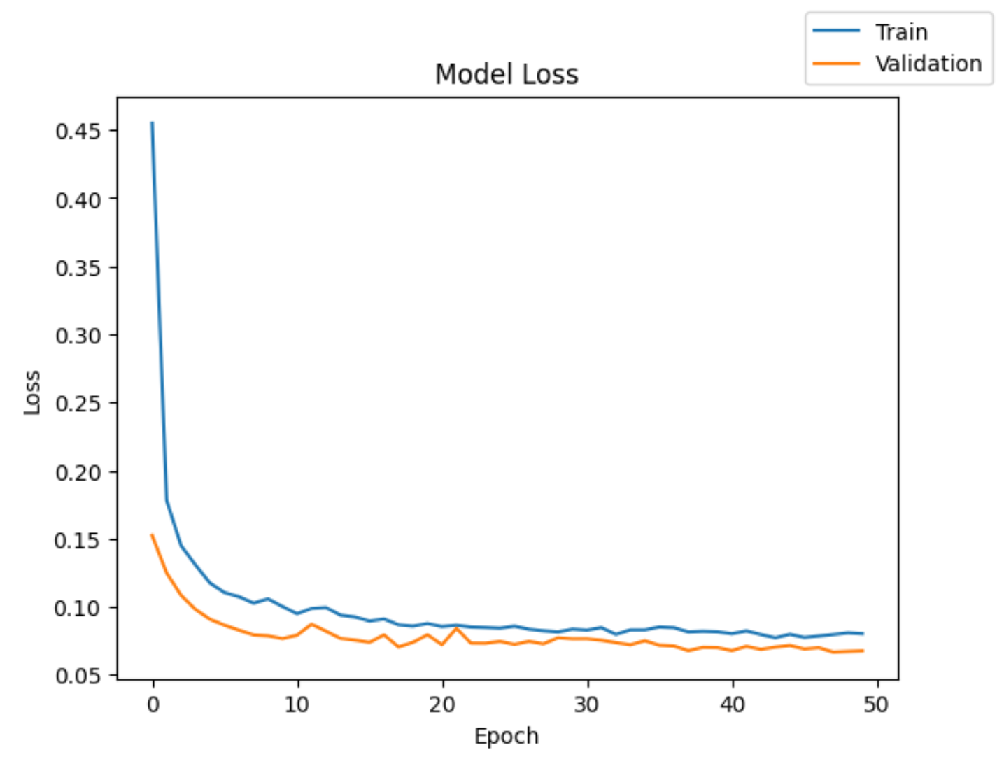
Model Performance : Model 5 - Adam Optimizer & Dropout
Predictors
40
Hidden Layers
# Neurons
Activation Function
Dropout
Output Layer
Activation Function
Optimizer
Adam
Epochs
50
1
14
Relu
0.5
1
Sigmoid
Loss Function
binary_crossentropy
Batch Size
64
2
14
Relu
-
Metric
Recall
3
7
Relu
-
Execution Time
44.01 sec
Data | Accuracy | Recall | Precision | F1 Score
Training | 0.98125 | 0.833201 | 0.987036 | 0.894006
Validation | 0.982 | 0.842078 | 0.984406 | 0.899533
The Recall and Accuracy went down compared to model 4.
It appears Dropout is resulting in some information loss, due to which model performance is suffering.

Slide 23
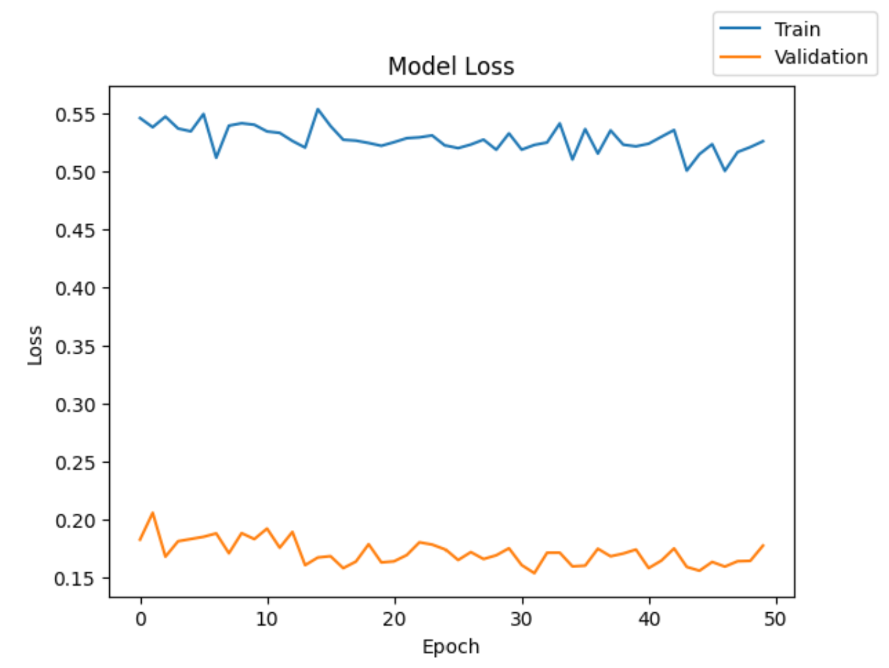
Model Performance : Model 6 - Adam Opt., Dropout & Class weight
Predictors
40
Hidden Layers
# Neurons
Activation Function
Dropout
Output Layer
Activation Function
Optimizer
Adam
Epochs
50
1
14
Relu
0.5
1
Sigmoid
Loss Function
binary_crossentropy
Batch Size
64
2
14
Relu
-
Metric
Class
Class Weight
Metric
Recall
3
7
Relu
-
0
1.0587
1
18.01
Execution Time
40.78 sec
Data | Accuracy | Recall | Precision | F1 Score
Training | 0.070187 | 0.481806 | 0.453202 | 0.069067
Validation | 0.0695 | 0.484092 | 0.456387 | 0.068293
The Recall and Accuracy went down significantly.
It appears Dropout is resulting in some information loss, due to which model performance is suffering.

Slide 24


